Slide 1
Review Exam 2

Slide 2
Deep learning and artificial neural networks

Slide 3

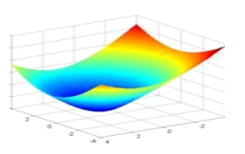
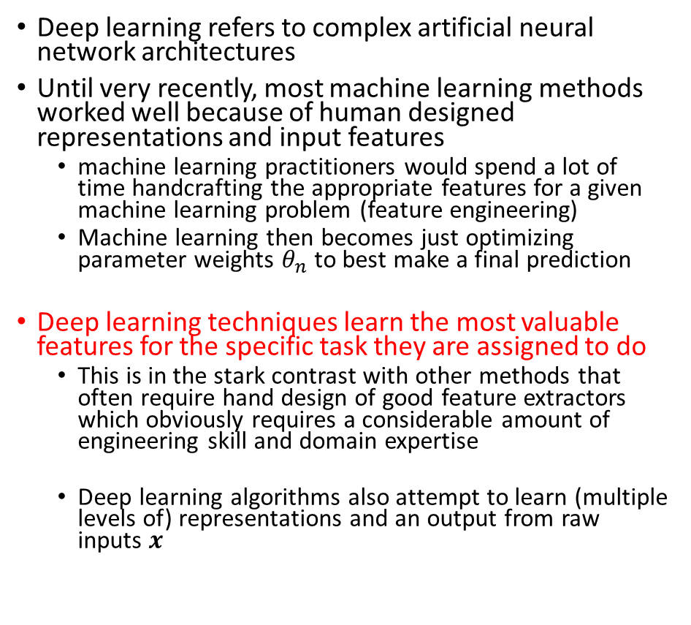
Deep learning Overview
Deep learning refers to complex artificial neural network architectures
Until very recently, most machine learning methods worked well because of human designed representations and input features
machine learning practitioners would spend a lot of time handcrafting the appropriate features for a given machine learning problem (feature engineering)
Machine learning then becomes just optimizing parameter weights $θ_{n}$ to best make a final prediction
Deep learning techniques learn the most valuable features for the specific task they are assigned to do
This is in the stark contrast with other methods that often require hand design of good feature extractors which obviously requires a considerable amount of engineering skill and domain expertise
Deep learning algorithms also attempt to learn (multiple levels of) representations and an output from raw inputs $x$

Slide 4
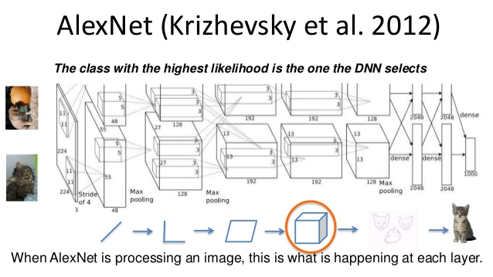
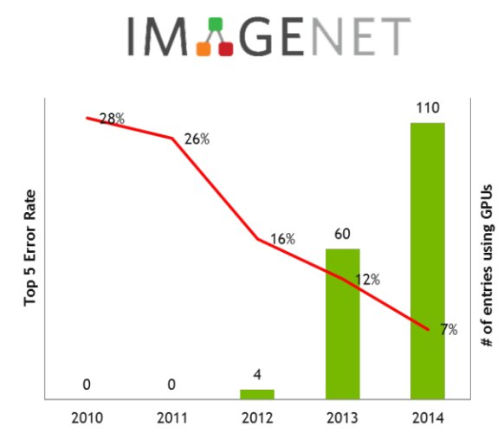
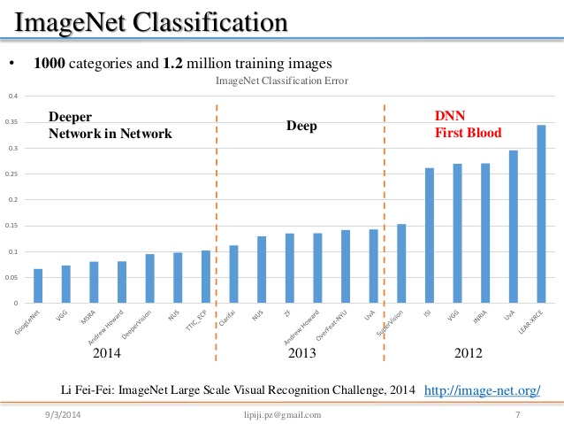
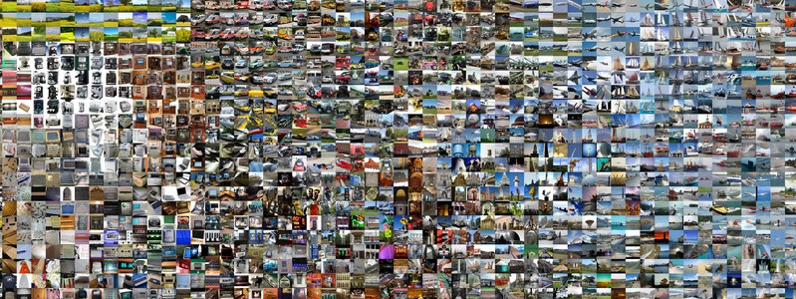
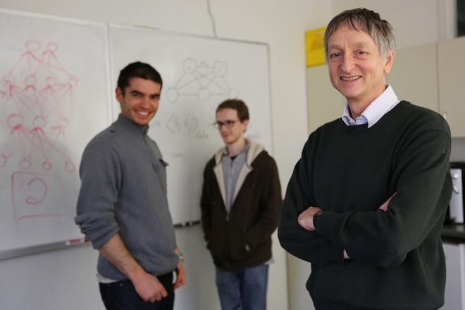
Historical Deep learning breakthrough for computer vision
The breakthrough DL paper: ImageNet Classification with Deep Convolutional Neural Networks by Krizhevsky, Sutskever, & Hinton, 2012, U. Toronto. 37% error red.
Many further successes in machine translation, NLP, etc.

Slide 5
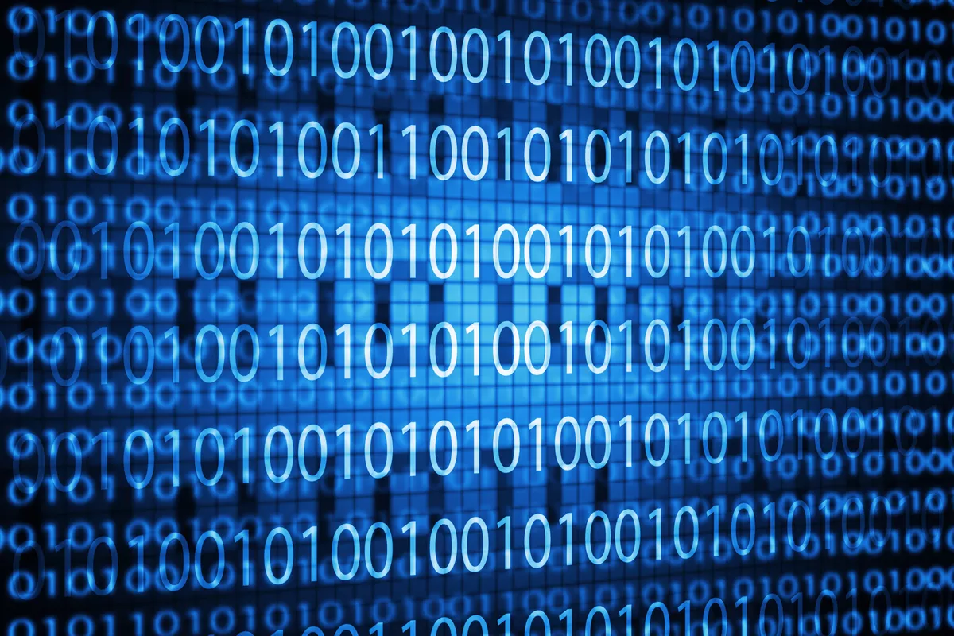
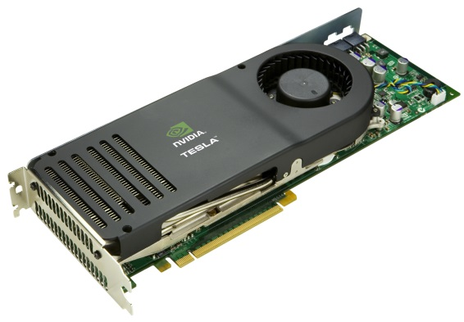
Why deep learning techniques work so well?
3. New models, algorithms, ideas
1. Data
2. Hardware improvements
Better activation functions for neural layers
Better weight-initialization schemes
Better optimization schemes, such as RMSProp and Adam
Better, learning of intermediate representations
Effective end to end joint system learning
Effective learning methods for using contexts and transferring between tasks
Deep models only shine when you have enough data to train them!
Vectorized computations on GPUs markedly outperform CPUs

Slide 6
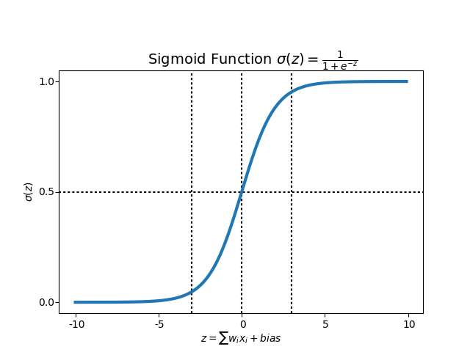
Artificial neural networks: computational architecture overview
$$y$$
$$X$$
$$a^{[1]}$$
$$W^{[1]}$$
$$W^{[2]}$$
$$a^{[2]}$$
$$W^{[3]}$$
$$x1$$
$$x2$$
$$x3$$
$$W_{11}$$
$$W_{21}$$
$$W_{31}$$
Activation function
Activation function
Activation function
$$W_{11}$$
$$x_{1}$$
$$W_{21}$$
$$W_{31}$$
$$x_{2}$$
$$x_{3}$$
Input layer
Hidden layer 1
Hidden layer 2
Output layer

Slide 7


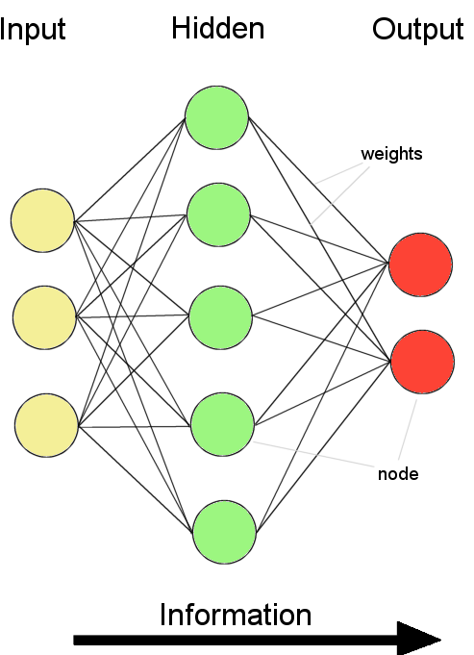
Network computational units: basically, logistic regression
$$X$$
$$y$$
$$x1$$
$$x2$$
$$x3$$
f is a nonlinear activation function

Slide 8
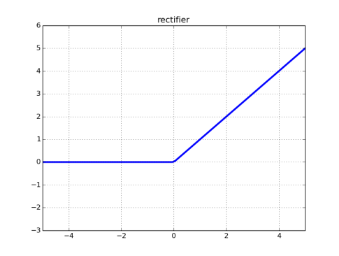

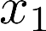
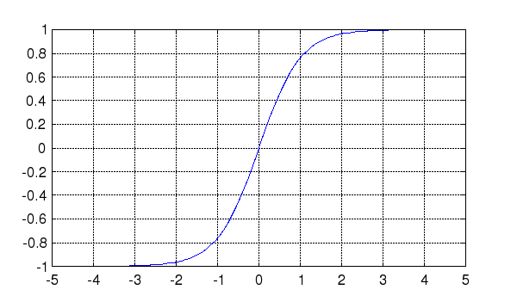
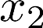
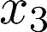
The nonlinear activation function $g$
rectifier neural unit (reLU ()
$$a$$
The activation function of each neuron unit is generally non-linear.
Linear functions are limited because the output is simply proportional to the input.
$$a=g\left(z\right)=max⁡(0,z)$$
$$z$$
$$x=\left[\begin{matrix}x1 \\ x2 \\ x3\end{matrix}\right]$$
$$W=θ=\left[\begin{matrix}θ1 \\ θ2 \\ θ3\end{matrix}\right]$$
sigmoid
$$a$$
$$a=g\left(z\right)=\frac{1}{1+e^{−z}}$$
$$z=x∙θ=\sum_{i=1}^{n−1}{θ_{i}x_{i}}=θ_{1}x_{1}+θ_{2}x_{2}+θ_{2}x_{2}$$
$$a=g\left(z\right)=g(\sum_{i=1}^{n−1}{θ_{i}x_{i}})$$
$$z$$
$$θ1$$
Hyperbolic tangent
$$θ2$$
$$a$$
$$a=g\left(z\right)=\frac{e^{z}−e^{−z}}{e^{z}+e^{−z}}$$
$$z$$
$$a=g(z)$$
$$a$$
$$θ3$$
$$z$$

Slide 9
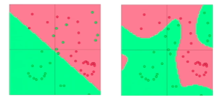
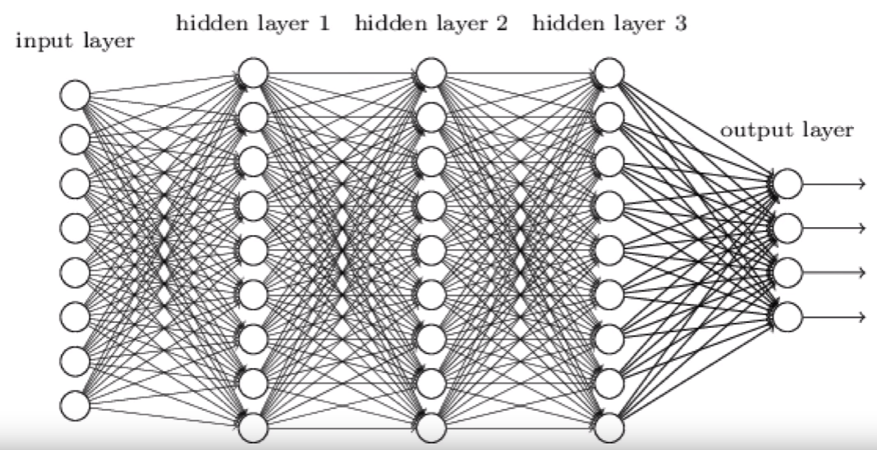
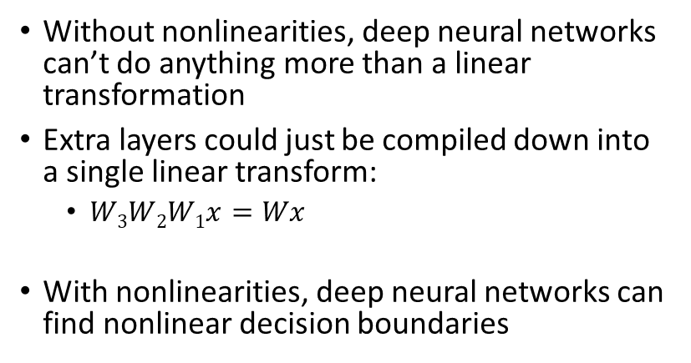
Why are nonlinearities functions needed?
Without nonlinearities, deep neural networks can’t do anything more than a linear transformation
Extra layers could just be compiled down into a single linear transform:
$W3W2W1x=Wx$
With nonlinearities, deep neural networks can find nonlinear decision boundaries
$$y=W_{4}∙W_{3}∙W_{2}{∙W}_{1}∙x$$
$$y={softmax(W}_{4}∙{g(W}_{3}∙{g(W}_{2}{∙g(W}_{1}∙x))))$$
$$x$$
$$W_{1}$$
$$a_{1}$$
$$W_{2}$$
$$a_{2}$$
$$W_{3}$$
$$a_{3}$$
$$W_{4}$$
$$y$$
$$a_{1}=g(W_{1}x)$$
$$a_{2}=g(W_{2}a_{1})$$
$$a_{3}=g(W_{3}a_{2})$$
$$y=softmax(W_{4}a_{3})$$
Notes:
This trick, makes the math very simple.
It takes the advantages of linear models
While simultaneously making the model more flexible and powerful by making it not linear

Slide 10
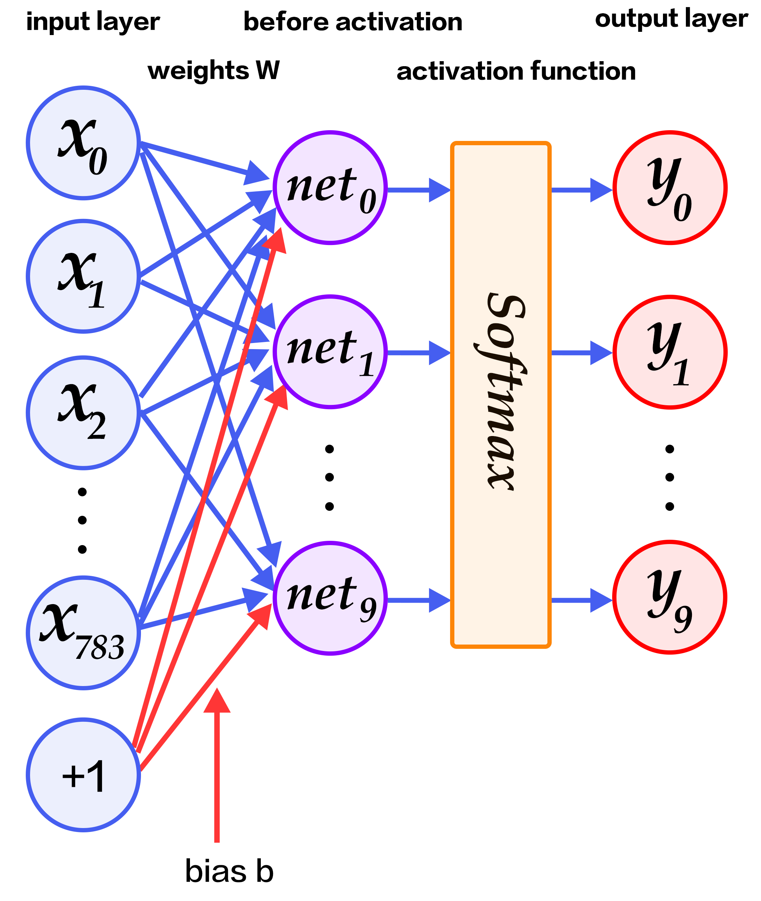
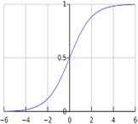
The softmax
Softmax is a special activation function for the last layer of an artificial neural network
Softmax is a generalization (up to as many classes as the task specifies) of sigmoid.
The sigmoid function is a special case of the softmax where the number of class equals to 2.
The softmax is used in the last layer of a neural network to output an n size vector with the probabilities of class membership
It transforms logits/scores/z from an infinite range into probabilities of class membership
z/Evidence/scores/logits
z=W_{i}x
$$P(y=0|X^{(i)})$$
$$P(y=1|X^{(i)})$$
$$P(y=9|X^{(i)})$$
$$softmax\left(z_{i}\right)=\frac{e^{z_{i}^{}}}{\sum_{j}{z_{i}}}$$
Probabilities

Slide 11
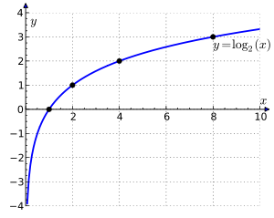
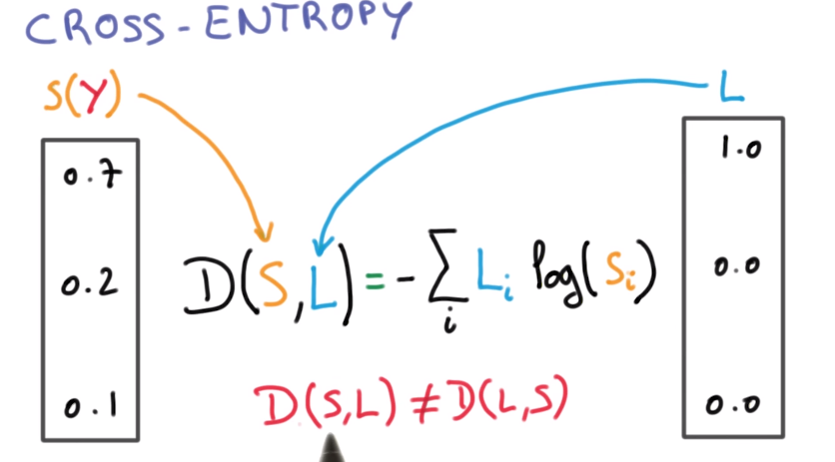
Loss function: Cross entropy
The natural way to measure the distance between those 2 probability vectors is called the cross entropy (a measurement of distance between vectors )
$$y=log⁡(x)$$
$$\hat{y}predictions$$
$$y$$

Slide 12
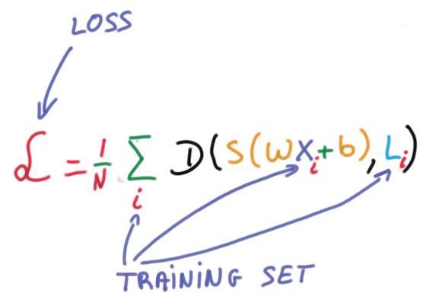

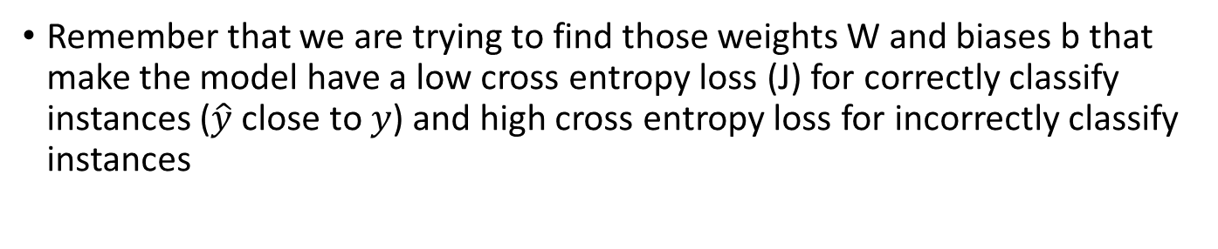
Cost/Loss function: Minimize average cross entropy
Remember that we are trying to find those weights W and biases b that make the model have a low cross entropy loss (J) for correctly classify instances ($\hat{y}$ close to $y$) and high cross entropy loss for incorrectly classify instances
$$ypredictions$$
$$J(W_{1},W_{2})$$
$$y$$
$$W_{1}$$
$$W_{2}$$

Slide 13
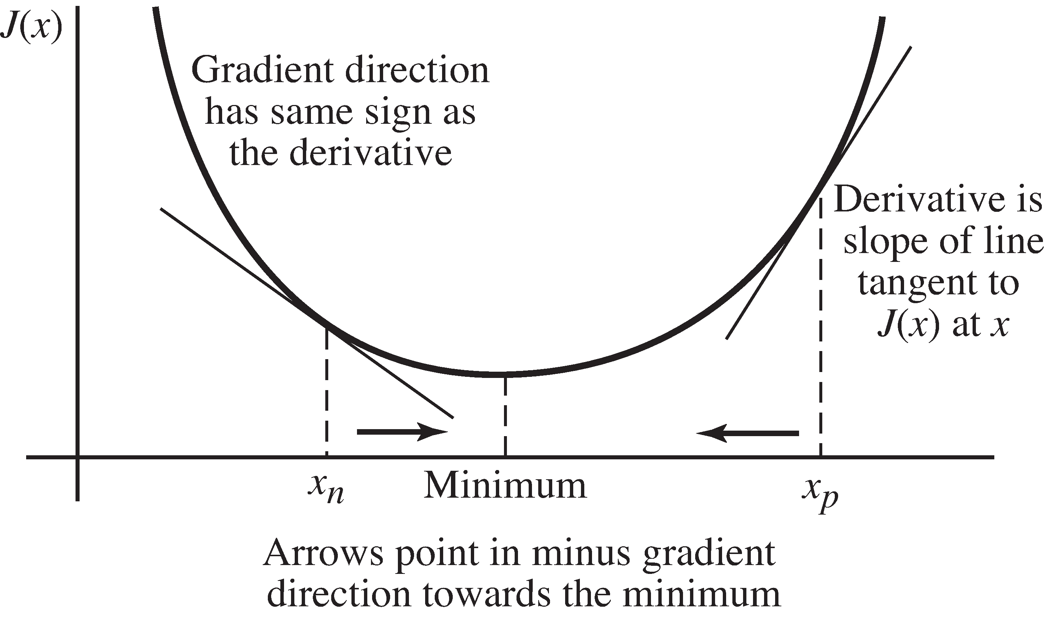
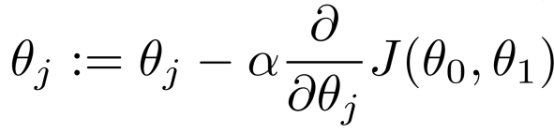
Gradient descent parameter update intuition
Learning Rate
$$θj$$

Slide 14
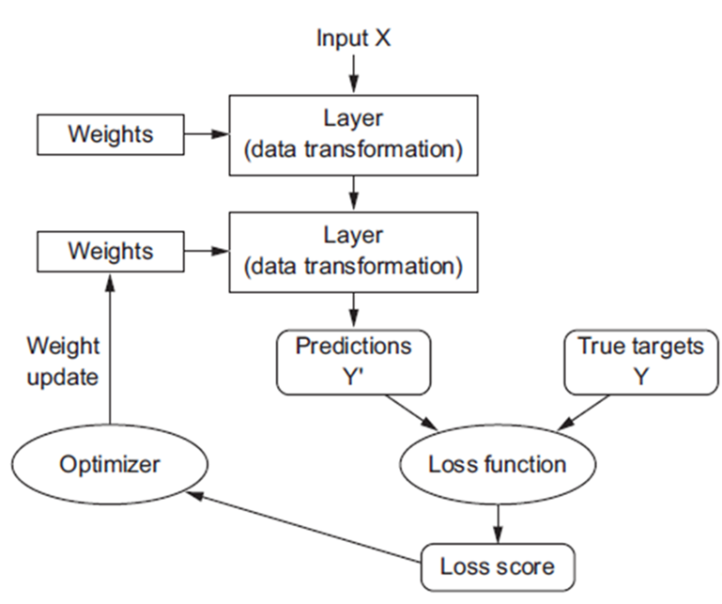
Anatomy of a neural network
Training a neural network revolves around the following objects:
Layers, which are combined into a network (or model)
The input data and corresponding targets
The loss function, which defines the feedback signal used for learning
The optimizer, which determines how learning proceeds
The network, composed of layers that are chained together, maps the input data to predictions
The loss function then compares these predictions to the targets, producing a loss value: a measure of how well the network’s predictions match what was expected
The optimizer uses this loss value to update the network’s weights
Notes:
yeah

Slide 15
Optimizer: The engine of neural networks (gradient-based optimization)
each neural layer from an archetypal network transforms its input data as follows:
output = relu(dot(W, input) + b)
In this expression, W and b are tensors that are attributes of the layer. They’re called the weights or trainable parameters of the layer
These weights contain the information learned by the network from exposure to training data.
Initially, these weight matrices are filled with small random values (a step called random initialization).
Of course, there’s no reason to expect that relu(dot(W, input) + b), when W and b are random, will yield any useful representations.
The resulting representations are meaningless—but they’re a starting point.
What comes next is to gradually adjust these weights, based on a feedback signal.
This gradual adjustment, also called training, is basically the learning that machine learning is all about.
Forward pass (input signals)
$$y$$
$$x$$
$$W_{1}$$
$$a_{1}$$
$$W_{2}$$
$$a_{2}$$
$$W_{3}$$
$$a_{3}$$
$$W_{4}$$
$$y={g(W}_{4}∙{g(W}_{3}∙{g(W}_{2}{∙g(W}_{1}∙x))))$$
Back propagation ( error signal)

Slide 16
Evaluating machine learning models
In machine learning, the goal is to achieve models that generalize (i.e. perform well on never-before-seen data)
Overfitting is the central obstacle to generalization
You can only control that which you can observe, so it’s crucial to be able to reliably measure the generalization power of your model.
Training data
Test data
Training data
Validation data
Test data
Still need a test data set for a final evaluation of the performance or generalization capabilities of your model
Test data

Slide 17

Neural networks and overfitting
“Small” neural network
(fewer parameters; more prone to underfitting, high bias)
“Large” neural network
(more parameters; more prone to overfitting, low bias)
Computationally cheaper
Computationally more expensive.
We can use regularization to address overfitting
15

Slide 18
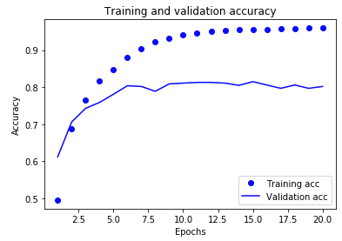
Overfitting (high variance) and underfitting (high bias)
The fundamental issue in machine learning is the tension between optimization and generalization.
Optimization refers to the process of adjusting a model to get the best performance possible on the training data
Generalization refers to how well the trained model performs on data it has never seen before
The goal of the game is to get good generalization
At the beginning of training, optimization and generalization are correlated: while this is happening, your model is said to be underfit: there is still progress to be made; the network hasn’t yet modeled all relevant patterns in the training data.
But after a certain number of iterations on the training data, generalization stops improving, and validation metrics stall and then begin to degrade: the model is starting to overfit.
That is, it’s beginning to learn patterns that are specific to the training data but that are misleading or irrelevant when it comes to new data.
To prevent a model from learning misleading or irrelevant patterns found in the training data, the best solution is to get more training data.
When that isn’t possible, the next-best solution is to modulate the quantity of information that your model is allowed to store or to add constraints on what information it’s allowed to store.
The processing of fighting overfitting this way is called regularization.

Slide 19
Overfitting
In deep learning we try to use complex/flexible/deep models that will capture complex patterns
We can use several techniques to prevent overfitting
Early termination
Reducing the network size
Regularization
Dropout
Get more training data

Slide 20
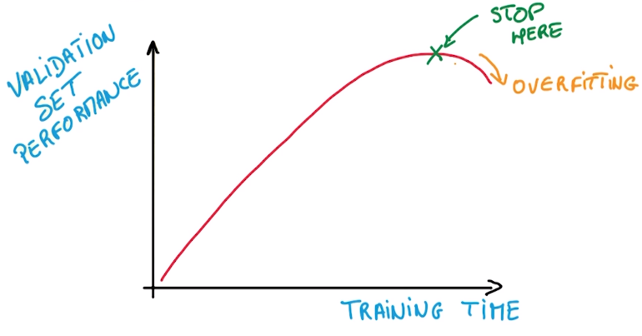
Techniques to prevent overfitting 1. Early termination

Slide 21
Techniques to prevent overfitting 2. Reducing the networks size
The simplest way to prevent overfitting is to reduce the size of the model:
the number of learnable parameters in the model (which is determined by the number of layers and the number of units per layer).
Intuitively, a model with more parameters has more memorization capacity/flexibility and therefore can easily learn a perfect dictionary-like mapping between training samples and their targets
But such a model could be useless for classifying new samples
If the network has limited memorization resources, it won’t be able to learn this mapping as easily; thus, in order to minimize its loss, it will have to resort to learning compressed representations that have predictive power regarding the targets
At the same time, keep in mind that you should use models that have enough parameters that they don’t underfit: your model shouldn’t be starved for memorization resources.
There is a compromise to be found between too much capacity and not enough capacity (bias/variance trade-off).
Notes:
Unfortunately, there is no magical formula to determine the right number of layers
or the right size for each layer. You must evaluate an array of different architectures
(on your validation set, not on your test set, of course) in order to find the
correct model size for your data. The general workflow to find an appropriate model
size is to start with relatively few layers and parameters, and increase the size of the layers
or add new layers until you see diminishing returns with regard to validation loss.

Slide 22
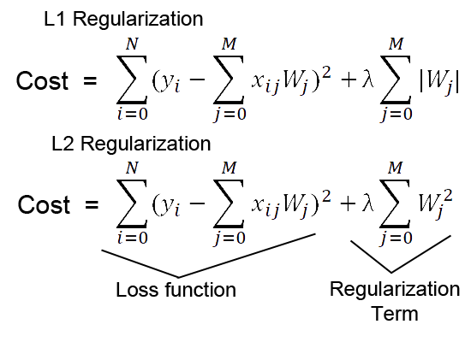
Techniques to prevent overfitting 3. weight regularization (weight shrinkage)
A simple model in the context of machine learning is a model where the distribution of parameter values take only small values, which makes the distribution of weight values more regular
This is called weight regularization, and it’s done by adding to the loss function of the network a cost associated with having large weights
This cost comes in two flavors:
L1 regularization—The cost added is proportional to the absolute value of the weight coefficients (the L1 norm of the weights).
L2 regularization (aka weight decay)—The cost added is proportional to the square of the value of the weight coefficients (the L2 norm of the weights).

Slide 23
Techniques to prevent overfitting 4. Dropout
Dropout, applied to a layer, consists of randomly dropping out (setting to zero) a number of output features of the layer during training
The dropout rate is the fraction of the features that are zeroed out
Let’s say a given layer would normally return a vector [0.2, 0.5, 1.3, 0.8, 1.1] for a given input sample during training.
After applying dropout, this vector will have a few zero entries distributed at random: for example, [0, 0.5, 1.3, 0, 1.1]
Strong neuro-biological analogy

Slide 24
Convolutional neural networks for computer vision

Slide 25
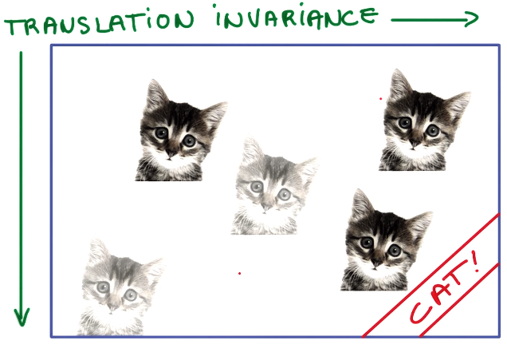
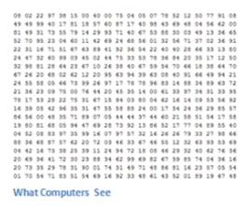
A big challenge for computer vision: Translational Invariance
Let’s say you want to detect cats in an image
You probably will want to recognize cats anywhere in the image
This capability is called translational invariance
The machine learning models we have seen so far do not scale well to this type of problem
You would need to train such models with data containing images of cats in different locations

Slide 26
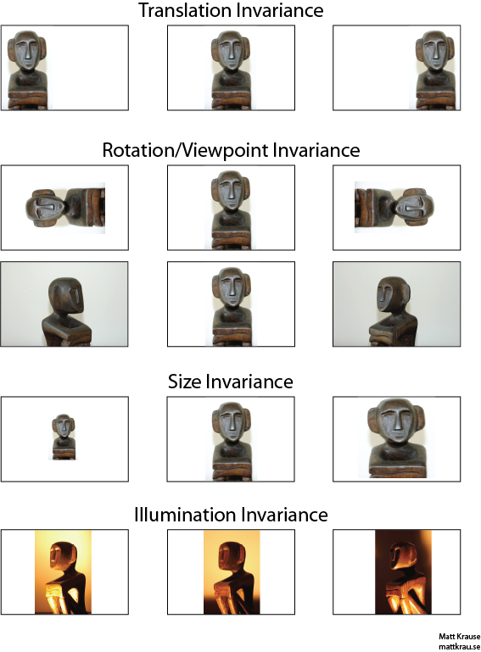
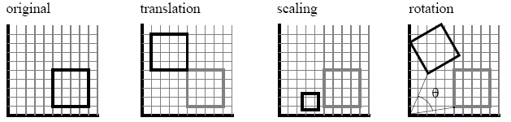
Other types of Invariance
The human brain is very good at handling several types of invariance
Hence, perception invariance seems trivial to us since we are very good at it
But achieving perception invariance is very hard for machine vision systems

Slide 27
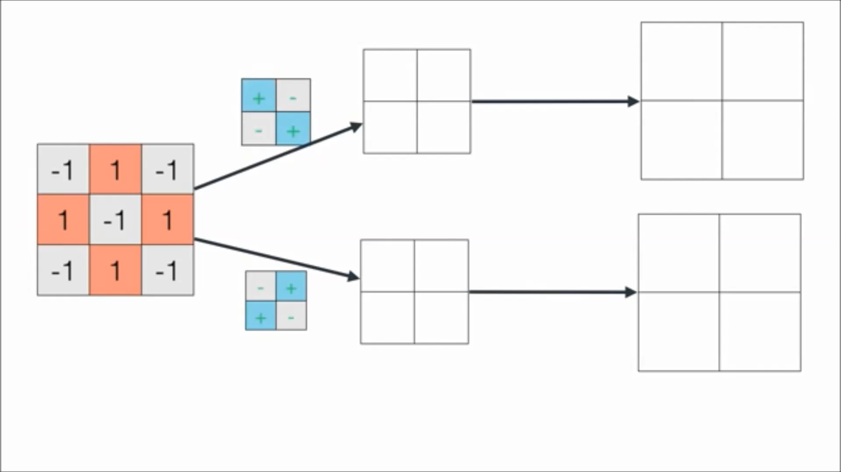
2D Convolution: degree of similarity (i.e. dot product) between a filter/kernel and each patch of the image to generate as output a feature map
Original
Image
Computer representation of the image
Kernels/Filters
Feature maps
Presence of features in original image

Slide 28

Convolutional networks
Convolutional neural networks share their parameters (weights/kernels/patches) across space
Output feature map
$$K_{11}$$
$$K_{12}$$
$$K_{13}$$
$$K_{21}$$
$$K_{22}$$
$$K_{23}$$
Kernel
$$K_{31}$$
$$K_{32}$$
$$K_{33}$$
Input feature map or original image

Slide 29
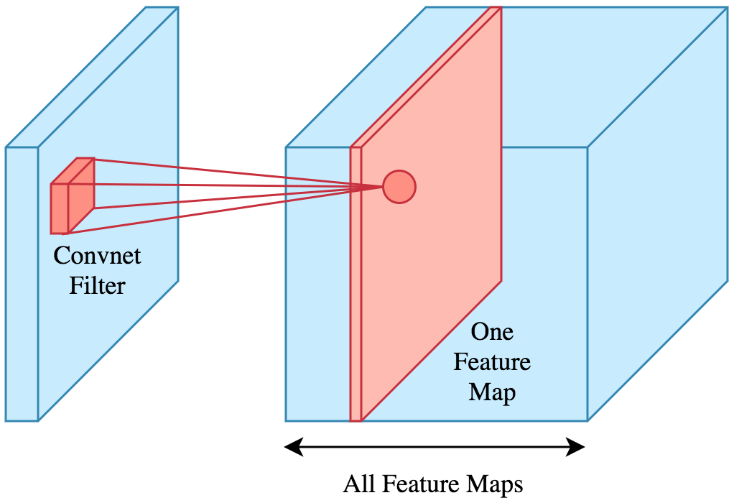
Each convolution layer generates as output several feature maps

Slide 30
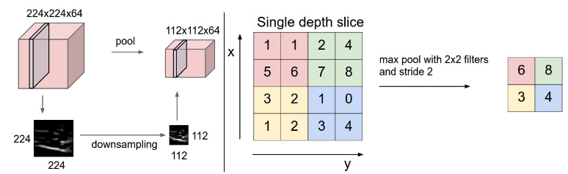
Pooling Layer
Large strides are a very aggressive way to downsample an image since it removes a lot of information
Pooling refers to using a very small stride and take all the convolutions in a neighborhood and combine them
It is common to periodically insert a Pooling layer in-between successive convolutional layers in a ConvNet architecture.
Its function is to progressively reduce the spatial size of the representation to reduce the amount of parameters and computation in the network, and hence to also control overfitting.
Left: In this example, the input volume of size [224x224x64] is pooled with filter size 2, stride 2 into output volume of size [112x112x64]. Notice that the volume depth is preserved.
Right: The most common downsampling operation is max ($y=max⁡(X_{i}$), giving rise to max pooling, here shown with a stride of 2. That is, each max is taken over 4 numbers (little 2x2 squares) .

Slide 31

Take-home message: typical architecture of convolutional neural network

Slide 32
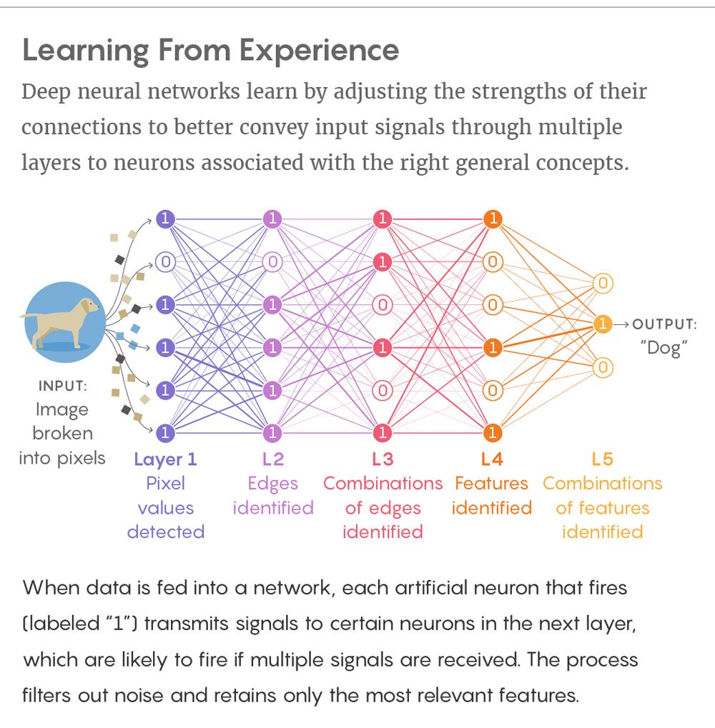
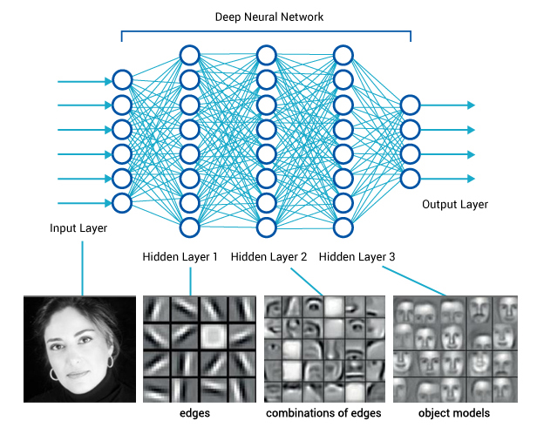
The reason why the deep models work so well is that a lot of natural phenomena tend to have a hierarchical structure of features that deep models naturally capture
Hierarchical representations creates parameter efficiency since higher-level representations share lower level parameters
Hierarchical representations are key for the generalization abilities of the network

Slide 33
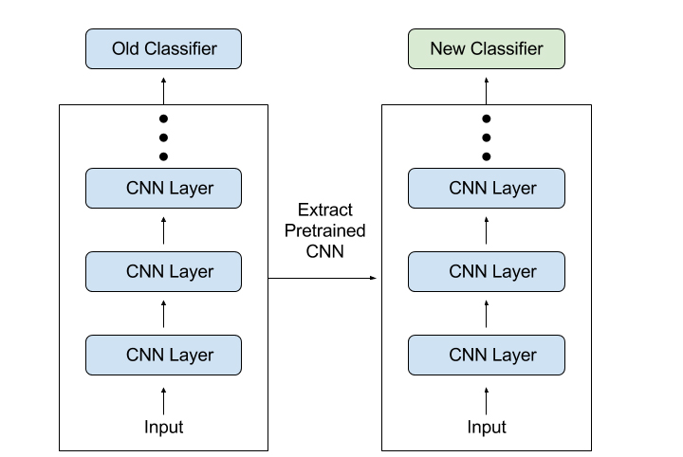
Transfer learning
Frozen (i.e. no back propagation)
Pretrained model
New model

Slide 34
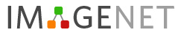
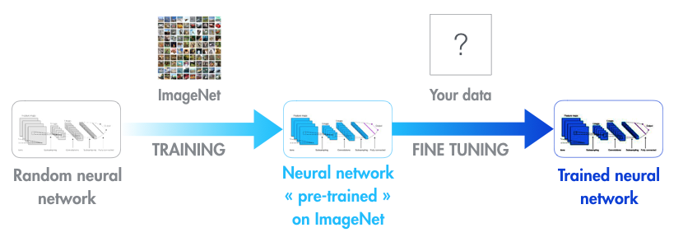
Transfer learning
Modern object recognition models have millions of parameters and can take weeks to fully train in large computer clusters.
In practice, very few people train an entire Convolutional Network from scratch (with random initialization)
because it is relatively rare to have a dataset of sufficient size
it is computationally expensive.
Instead, it is common to use a ConvNet pretrainned on a very large dataset (e.g. ImageNet, which contains 1.2 million images with 1000 categories), and then use the ConvNet either as an initialization or a fixed feature extractor for the task of interest.
Transfer learning takes a fully-trained model for a set of categories like ImageNet, and retrains from the existing weights for new classes only on the last fully connected layer of the network
ImageNet does not need to contain your new classes. However, the kinds of information/features (horizontal/vertical edges, etc) that make it possible for ImageNet to differentiate among its original1,000 classes are also useful for distinguishing other objects.

Slide 35
Word Vectors/Word Embeddings

Slide 36
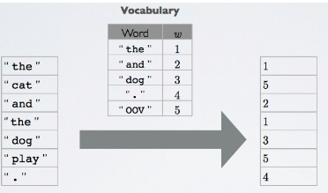
The issue with representing words for machine learning algorithms
Machine learning algorithms need numerical data as input
Several methods have been used in the past to transform words into numerical representations with sub optimal results
Working with vectors of indexes does not work well with machine learning algorithms
associating each word with an index

Slide 37
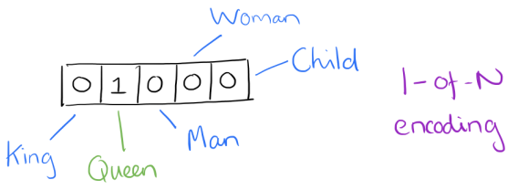
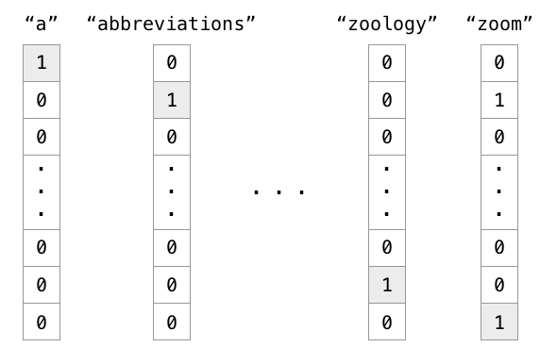
The issue with representing words for machine learning algorithms
An improvement over vectors of indexes is the one hot encoding of words
Suppose our vocabulary has only five words: King, Queen, Man, Woman, and Child. We could encode the word ‘Queen’ as:
Notice that the typical vocabulary size of a human language will be between 10,000 and 200,000 words
One hot encoded vectors are extremely sparse and wasteful
Using such an encoding, there’s no meaningful comparison we can make between word vectors other than equality testing

Slide 38
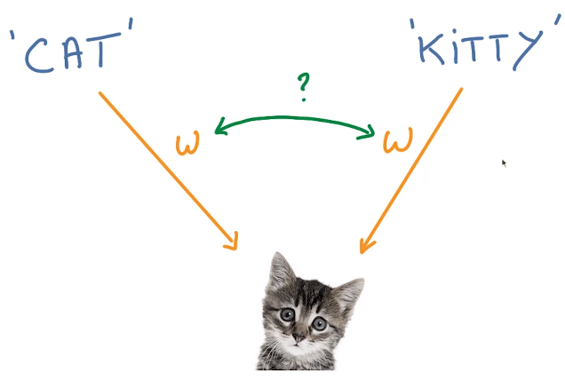
The issue with representing words for machine learning algorithms
Semantic ambiguity
We often use different words to mean almost the same thing
Like with image recognition, when we have things that are similar, it is very useful to share parameters
How do we represent words to a machine learning algorithm?
Discrete representations don’t work well
The previous 2 methods do not provide an efficient way of comparing word similarity

Slide 39
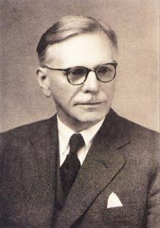
Distributional semantics
Research area that develops and studies theories and methods for quantifying and categorizing semantic similarities between linguistic items based on their distributional properties in large samples of language data
The distributional hypothesis in linguistics postulates that words that are used in the same contexts tend to purport similar meanings
The underlying idea was popularized by Firth in 1957
“a word can be characterized by the company it keeps"
John R. Firth
I need to $\left(\begin{matrix}learn \\ he \\ \begin{aligned}study \\ car \\ dance\end{aligned}\end{matrix}\right)$ for the exam tomorrow

Slide 40
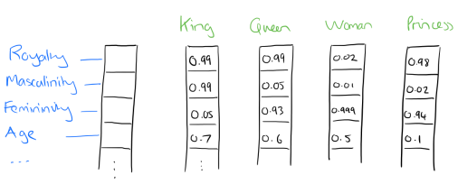
Word Embeddings/word vectors
Word embeddings and Word vectors are equivalent terms referring to the same thing
Word embeddings are distributed representation of a word
Take a vector with several hundred dimensions (say 100)
Each word can be representated by a distribution of weights across those elements
So instead of a one-to-one mapping between an element in the one hot encoded vector and a word, the representation of a word is spread across all of the elements in the vector, and each element in the vector contributes to the definition of many words
Such a vector comes to represent in some abstract way the ‘meaning’ of a word.
Using neural networks trained on a large corpus, it’s possible to learn word vectors that are able to capture the relationships between words in a surprisingly expressive way.
We can then use the vectors as inputs to a neural network for natural language processing tasks

Slide 41

Word2vec training data
(target word, context word)
(target word, random word)
Positive
training samples
Negative
training samples
(the, red)
(the, an)
(quick, table)
(quick, school)
(quick, due)
(brown, psychology)
(brown, name)
(brown, published)
(brown, microphone)
(fox, institutional)
(fox, statement)
(fox, project)
(fox, research)

Slide 42
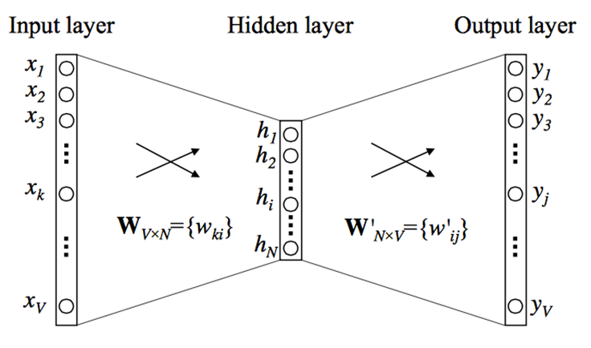

Learning word vectors
Word2vec offers two different neural network architectures to learn word embeddings: a Continuous Bag-of-Words model (CBOW) , and a Continuous Skip-gram model.

Slide 43


Estimating word similarity: cosine similarity
$$y=cos⁡(x)$$

Slide 44

Take-home message

Slide 45
Recurrent Neural Networks

Slide 46

The limitation of neural networks presented so far
A major characteristic of all neural networks you’ve seen so far such as densely connected networks and convnets, is that they have no memory.
Each input shown to them is processed independently, with no state kept in between inputs.
With such networks, in order to process a sequence or a temporal series of data points, you have to show the entire sequence to the network at once:
turn the time series into a single data point.
For instance, this is what you did in the IMDB example: an entire movie review was transformed into a single large vector and processed in one go.
Such networks are called feedforward networks.

Slide 47


Temporal structure
In contrast, as you’re reading the present sentence, you’re processing it word by word while keeping memories of what came before
this gives you a fluid representation of the meaning conveyed by this sentence.
Biological intelligence processes information incrementally while maintaining an internal model (state) of what it’s processing, built from past information and said model is constantly updated as new information comes in

Slide 48
Recurrent neural network (RNN)
A recurrent neural network (RNN) processes sequences by iterating through the sequence elements and maintaining a state containing information relative to what it has seen so far.
In effect, an RNN is a type of neural network that has an internal loop
The state of the RNN is reset between processing two different, independent sequences (such as two different IMDB reviews), so you still consider one sequence a single data point: a single input to the network.
What changes is that this data point is no longer processed in a single step; rather, the network internally loops over sequence elements.

Slide 49

Recurrent neural networks (RNNs)
If you have a sequence of events, at each point in time you want to make a decision about what has happened so far in the sequence
You can use the same classifier at each point in time which simplifies things a lot
But since this is a sequence you also want to take into account the past
A natural thing to do is to use the state of the previous classifier as a summary of what has happened before
This can be better understood if we unfold the graph of a RNN over time
output
state
input

Slide 50


The big limitation of Recurrent neural networks (RNN)
RNNs are great… in theory
In practice, they often fail to deliver
This is because to compute the parameter updates of a recurrent network we need to back propagate derivatives through time
All these derivatives are going to be applied to the same parameters
That’s a lot of correlated updates which is bad for SGD since it is numerically unstable (underflow or overflow problems)

Slide 51


Vanishing gradient problem
Backpropagation, the master algorithm used to train deep neural networks, works by propagating a feedback signal from the output loss down to earlier layers.
If this feedback signal has to be propagated through a deep stack of layers, the signal may become tenuous or even be lost entirely, rendering the network untrainable.
This issue is known as vanishing gradients .
Vanishing gradients make your model only remember recent events and forget the more distant past
But in some sequences, what happened in the distant past is very relevant to understand the present time point

Slide 52








How to address vanishing gradients: LSTM (long short-term memory)
Jürgen Schmidhuber
An LSTM substitutes a traditional neural net with an LSTM cell
This greatly reduces the vanishing gradient problem
Here is one way of writing that idea as a computational diagram of gates
Memory: matrix of values
Inputs coming into the memory
Gate
Outputs coming out of memory

Slide 53


The LSTM cell will be better able to remember a piece of information and keep it saved for many timesteps.

Slide 54


End to end training – neural encoder-decoder architectures

Slide 55

What can you do with an LSTM based RNN?
LSTMs as generative models
You can build and train sequence-to-sequence neural network using LSTMs
Such models are useful for machine translation, parsers, music generation…
And as chatbots (conversational agents)

Slide 56

GRUs
Gated recurrent units (GRUs) are a gating mechanism in recurrent neural networks, introduced in 2014 by Kyunghyun Cho et al.
Their performance on some sequence data (speech signal modeling for instance) was found to be similar to that of long short-term memory (LSTM).
GRUs also exhibit better performance on smaller datasets.
They have fewer parameters than LSTM, as they lack an output gate and are cheaper to train
They are computationally cheaper to run in a model

Slide 57
Generative models

Slide 58
Approaches to generative models
To train a generative model we first collect a large amount of data in some domain (e.g., think millions of images, sentences, or sounds, etc.) and then train a model to generate data like it
There are two main approaches to generative models:
Generative Adversarial Networks (GANs), pose the training process as a game between two separate networks: a generator network and a second discriminative network that tries to classify samples as either coming from the true distribution or the model distribution. Every time the discriminator notices a difference between the two distributions the generator adjusts its parameters slightly to make it go away, until at the end (in theory) the generator exactly reproduces the true data distribution and the discriminator is guessing at random, unable to find a difference.
Variational Autoencoders (VAEs) allow us to formalize this problem in the framework of probabilistic graphical models where we are maximizing a lower bound on the log likelihood of the data.

Slide 59
Encoder and decoder network
A type of network that aims to encode an input to a low-dimensional latent space and then decode it back
A classical image autoencoder takes an image, maps it to a latent vector space via an encoder module, and then decodes it back to an output with the same dimensions as the original image, via a decoder module
It’s then trained by using as target data the same images as the input images, meaning the autoencoder learns to reconstruct the original inputs.
Most commonly, you’ll constrain the code to be low-dimensional and sparse (mostly zeros), in which case the encoder acts as a way to compress the input data into fewer bits of information.

Slide 60




The smile vector
Increase weight of k
$${image}_{output}={image}_{input}+{k∙vector}_{smile}$$
$$+k∙\left[\begin{matrix}v_{1} \\ \begin{matrix}v_{2} \\ … \\ …\end{matrix} \\ v_{n}\end{matrix}\right]$$
$$=$$
$${image}_{output}={image}_{input}−{k∙vector}_{smile}$$
$$+k∙\left[\begin{matrix}v_{1} \\ \begin{matrix}v_{2} \\ … \\ …\end{matrix} \\ v_{n}\end{matrix}\right]$$
$$=$$

Slide 61


Generative adversarial networks
Here we introduce a discriminator network (usually a standard convolutional neural network) that tries to classify if an input image is real or generated.
For instance, we could feed the 200 generated images and 200 real images into the discriminator and train it as a standard classifier to distinguish between the two sources.
But in addition to that — and here’s the trick — we can also backpropagate through both the discriminator and the generator to find how we should change the generator’s parameters to make its 200 samples slightly more confusing for the discriminator.
These two networks are therefore locked in a battle: the discriminator is trying to distinguish real images from fake images and the generator is trying to create images that make the discriminator think they are real.
In the end, the generator network is outputting images that are indistinguishable from real images for the discriminator.
Images produced by the generator

Slide 62
Artificial Intelligence APIs
AI computation (training, inference,…) carried out in a remote server
AI functionality brought over the web to a client using a RESTful API
For instance how speech input works in android phones

Slide 63

IBM Watson services

Slide 64
Reinforcement learning

Slide 65





Introduction
Reinforcement Learning (RL) is one of the most exciting fields of Machine Learning today, and also one of the oldest.
It has been around since the 1950s, producing many interesting applications over the years,in particular in games (e.g., TD-Gammon, a Backgammon playing program) and in machine control, but seldom making the headline news.
But a revolution took place in 2013 when researchers from an English startup called DeepMind demonstrated a system that could learn to play just about any Atari game from scratch, eventually outperforming humans in most of them, using only raw pixels as inputs and without any prior knowledge of the rules of the games.
This was the first of a series of amazing feats, culminating in March 2016 with the victory of their system AlphaGo against Lee Sedol, the world champion of the game of Go.
No program had ever come close to beating a master of this game, let alone the world champion.
This occurred in a game that was thought too difficult for machines to learn.
Today the whole field of RL is boiling with new ideas, with a wide range of applications.
DeepMind was bought by Google for over 500 million dollars in 2014.

Slide 66

Learning to optimize rewards
In Reinforcement Learning, a software agent makes observations and takes actions within an environment, and in return it receives rewards (-punishments).
Its objective is to learn to act in a way that will maximize its expected long-term rewards.
Huge implications for robotics
Notes:
This is quite a broad setting, which can apply to a wide variety of tasks. Here are a few examples :
The agent can be the program controlling a walking robot. In this case, the environment is the real world, the agent observes the environment through a set of sensors such as cameras and touch sensors, and its actions consist of sending signals to activate motors. It may be programmed to get positive rewards whenever it approaches the target destination, and negative rewards whenever it wastes time, goes in the wrong direction, or falls down.
The agent can be the program controlling Ms. Pac-Man. In this case, the environment is a simulation of the Atari game, the actions are the nine possible joystick positions (upper left, down, center, and so on), the observations are screenshots, and the rewards are just the game points.
Similarly, the agent can be the program playing a board game such as the game of Go.
The agent does not have to control a physically (or virtually) moving thing. For example, it can be a smart thermostat, getting rewards whenever it is close to the target temperature and saves energy, and negative rewards when humans need to tweak the temperature, so the agent must learn to anticipate human needs.
The agent can observe stock market prices and decide how much to buy or sell every second. Rewards are obviously the monetary gains and losses.

Slide 67






Introduction to OpenAI Gym
One of the challenges of Reinforcement Learning is that in order to train an agent, you first need to have a working environment.
If you want to program an agent that will learn to play an Atari game, you will need an Atari game simulator.
If you want to program a walking robot, then the environment is the real world and you can directly train your robot in that environment,
But this has its limits: if the robot falls off a cliff, you can’t just click “undo.”
You can’t speed up time either; adding more computing power won’t make the robot move any faster.
And it’s generally too expensive to train 1,000 robots in parallel.
In short, training is hard and slow in the real world, so you generally need a simulated environment at least to bootstrap training
OpenAI gym is a toolkit that provides a wide variety of simulated environments
(Atari games, board games, 2D and 3D physical simulations, and so on), so you can
train agents, compare them, or develop new RL algorithms.

Slide 68

Open AI Gym Nchain environment
The NChain example on Open AI Gym is a simple 5 state environment.
There are two possible actions in each state, move forward (action 0) and move backwards (action 1).
When action 1 is taken, i.e. move backwards, there is an immediate reward of 2 given to the agent – and the agent is returned to state 0 (back to the beginning of the chain). However, when a move forward action is taken (action 0), there is no immediate reward until state 4. When the agent moves forward while in state 4, a reward of 10 is received by the agent.
The agent stays in state 4 at this point also, so the reward can be repeated.
There is also a random chance that the agent’s action is “flipped” by the environment (i.e. an action 0 is flipped to an action 1 and vice versa).

Slide 69



Reward table
There are a number of issues with a naïve way of doing reinforcement learning:
Because no reward is obtained for most of the states when action 0 is picked, this model for training the agent has no way to encourage acting on delayed reward signal when it is appropriate for it to do so.
Once there is a reward stored in one of the columns, the agent will always choose that action from that point on. This will lead to the table being “locked in” with respect to actions after just a few steps in the game.
$$\left[\begin{matrix}\begin{matrix}0 \\ 0 \\ \begin{matrix}0 \\ 0\end{matrix}\end{matrix} & \begin{matrix}639006 \\ 129034 \\ \begin{matrix}25418 \\ 4944\end{matrix}\end{matrix} \\ 0 & 2762\end{matrix}\right]$$

Slide 70

Delayed reward reinforcement learning
We can bring the concept of delayed gratification (aka future time orientation) into our understanding of reinforcement learning.
Let’s say we are in state 3 – in the previous case, when the agent chose action 0 in state 3, the reward was zero and therefore $r_{table}(3, 0) = 0$.
Obviously the agent would not see this as an attractive step compared to the alternative for this state i.e. $r_{table}(3, 1) =2$.
But what if we assigned to $r_{table}(3, 0)$ the reward the agent would received if it chose action 0 again in state 4 ($r_{table}(4, 0)$)?
$r_{table}(3, 0)$ = 0 + 10 = 10 – a much more attractive alternative!

Slide 71


Q – learning algorithm
This idea of propagating possible reward from the best possible actions in future states is a core component of Q learning.
In Q learning, the Q value for each action in each state is updated when the relevant information is made available.
The Q learning (Q table updating rule) is:
Current Q-table value we are updating
Learning rate (restricts the updating to ensure it doesn’t “race” to a solution)
Reward hat was obtained when action $a$ was taken in state $s$
Discount factor (decreases the impact of future rewards on the immediate decision making in state s. This represents a limited patience in the agent – it won’t study forever to get that BIT degree.)
Estimated reward from our next state/action pair (the agent is looking forward to determine the best possible future rewards before making the next step a. notice the recursive nature of the call. $Q(s’,’a’)$implicitly also holds the maximum discounted reward for the state after that, $Q(s’’,a’’)$,and likewise, it holds the discounted reward for the state $Q(s’’’,a’’’)$ and so on…
Normalizes and restrict the growth of the Q value as the training of the agent progresses

Slide 72


Exploration versus exploitation
At the beginning of an optimization problem, it is best to allow the problem space to be explored extensively in the hope of finding good local (or even global) minima.
However, once the problem space has been adequately searched, it is now best for the optimization algorithm to focus on exploiting what it has found by converging on the best minima to arrive at a good solution.
Therefore, in reinforcement learning, it is best to allow some randomness in the action selection at the beginning of the training.
This randomness is determined by the epsilon parameter. Essentially, a random number is drawn between 0 and 1, and if it is less than epsilon, then a random action is selection. If not, an action is selected based on the output of the neural network. The epsilon variable usually starts somewhere close to 1, and is slowly decayed to somewhere around 0 during training. This allows a large exploration of the game at the beginning, but then the decay of the epsilon value allows the network to zero in on a good solution

Slide 73


Neural network architecture for reinforcement learning
To develop a neural network which can perform Q learning, the input needs to be the current state (plus potentially some other information about the environment) and it needs to output the relevant Q values for each action in that state.
The Q values which are output should approach, as training progresses, the values produced in the Q learning updating rule. Therefore, the loss or cost function for the neural network should be:

